Slide 1
Road Safety Assessments
in project
development
Wednesday, September 6, 2023
by: Mike Vaughn, PE

Slide 2
Road Safety Assessment Definition:
From FHWA’s RSA webpage:
A formal safety performance examination of an existing or future road or intersection by an independent, multi-disciplinary team.

Slide 3
Road Safety Assessment Definition:
From FHWA’s RSA webpage:
A formal safety performance examination of an existing or future road or intersection by an independent, multi-disciplinary team.

Slide 4
Road Safety Assessment Definition:
From FHWA’s RSA webpage:
A formal safety performance examination of an existing or future road or intersection by an independent, multi-disciplinary team.

Slide 5
Road Safety Assessment Definition:
From FHWA’s RSA webpage:
A formal safety performance examination of an existing or future road or intersection by an independent, multi-disciplinary team.

Slide 6
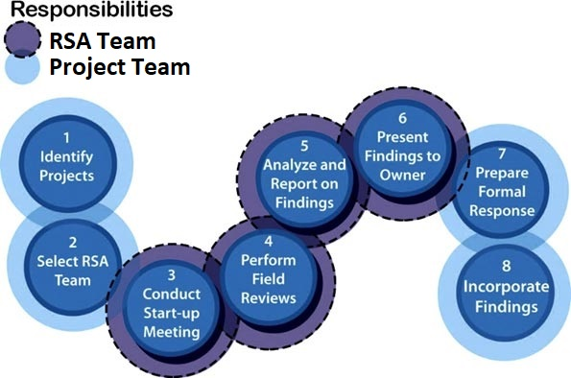
Source: FHWA

Slide 7
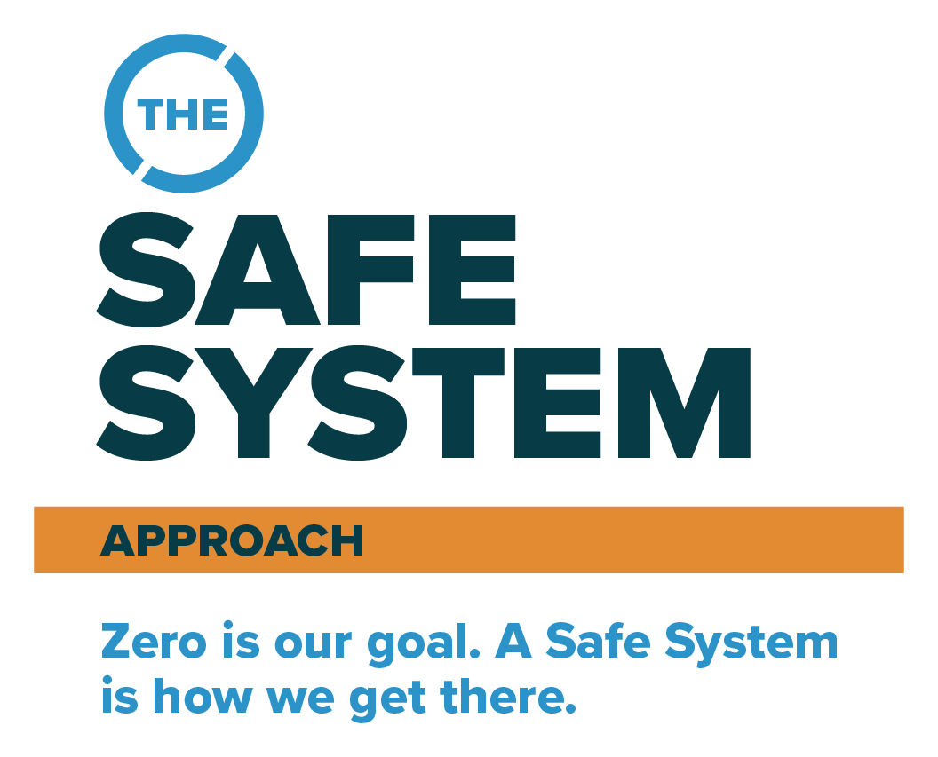
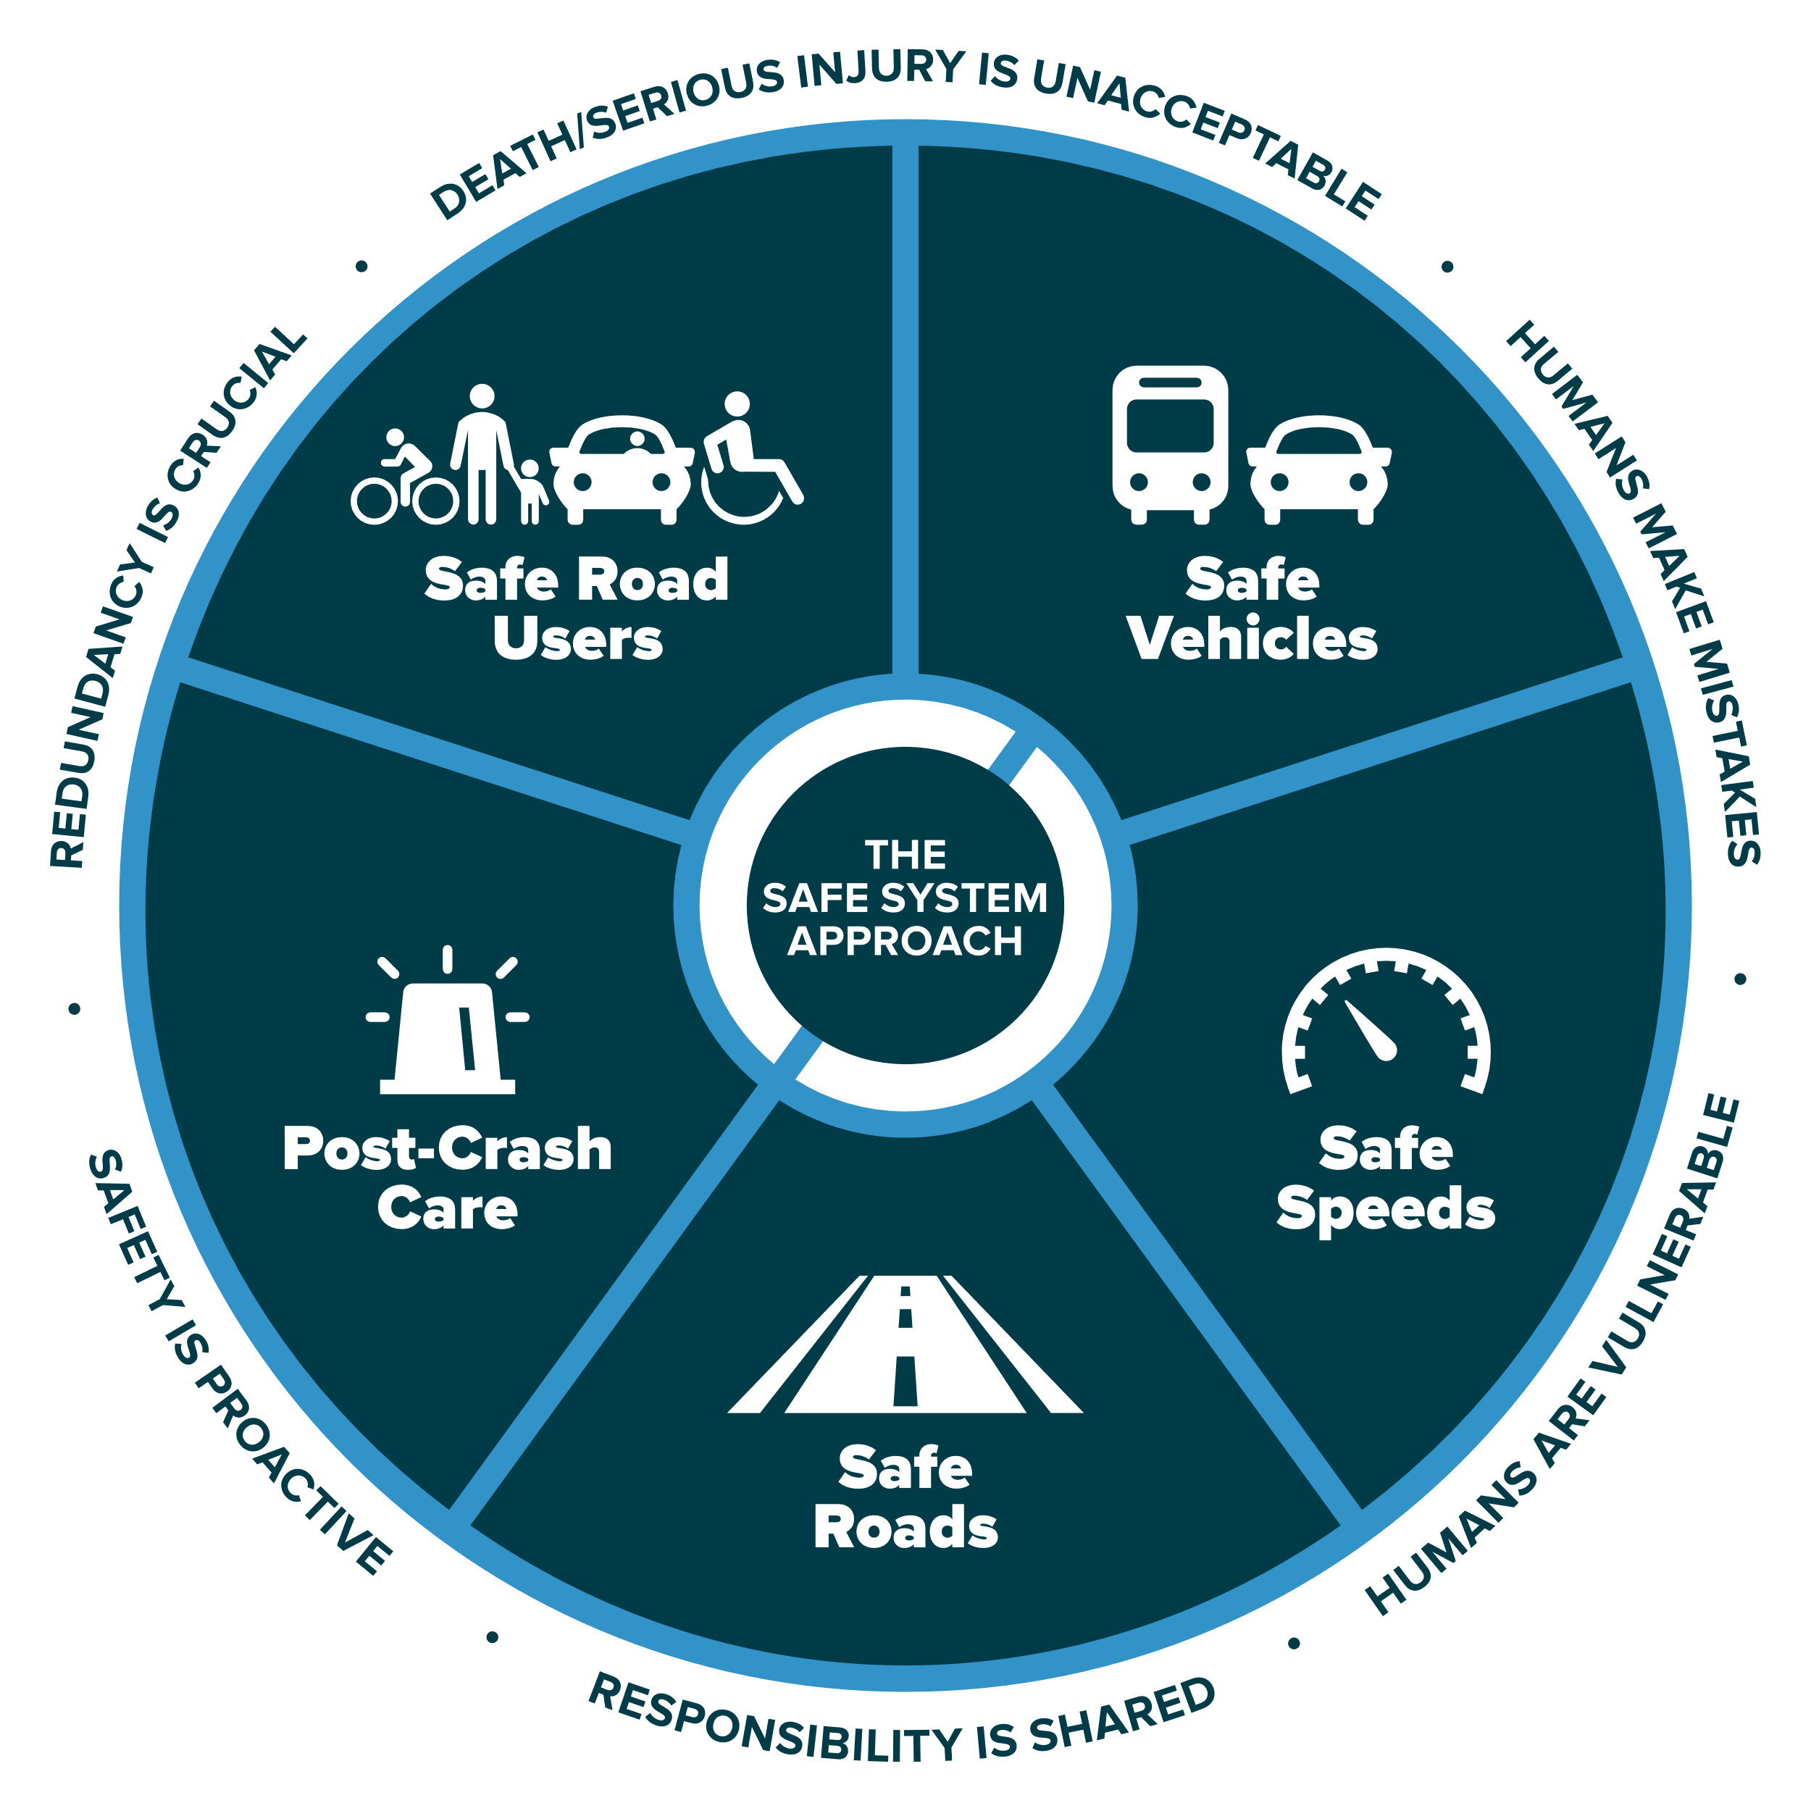

Slide 8
RSAs are a great way to implement the Safe System Approach
Safe System Principles
Safe System Elements
Humans make mistakes
Humans are vulnerable
Death & Serious Injuries are unacceptable
Safety is proactive
Redundancy is crucial
Responsibility is shared
Safe road users
Safe vehicles
Safe speeds
Safe roads
Post-crash care

Slide 9
RSAs are a great way to implement the Safe System Approach
Safe System Principles
Safe System Elements
Humans make mistakes
Humans are vulnerable
Death & Serious Injuries are unacceptable
Safety is proactive
Redundancy is crucial
Responsibility is shared
Safe road users
Safe vehicles
Safe speeds
Safe roads
Post-crash care

Slide 10
What causes Fatal & Serious Injury Crashes?

Slide 11
What causes Fatal & Serious Injury Crashes?
The transfer of too much kinetic energy to the human body.
Kinetic Energy = ½ mass x velocity²

Slide 12
What causes Fatal & Serious Injury Crashes?
The transfer of too much kinetic energy to the human body.
Kinetic Energy = ½ mass x velocity²
As transportation system managers, our number focus need to be:
managing kinetic energy!

Slide 13
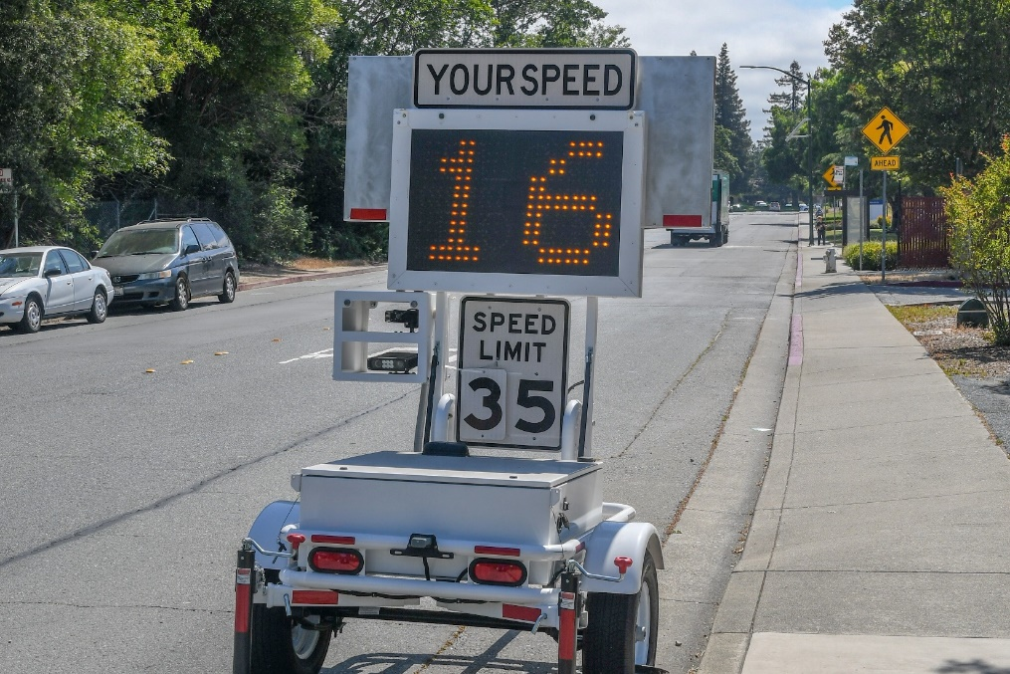
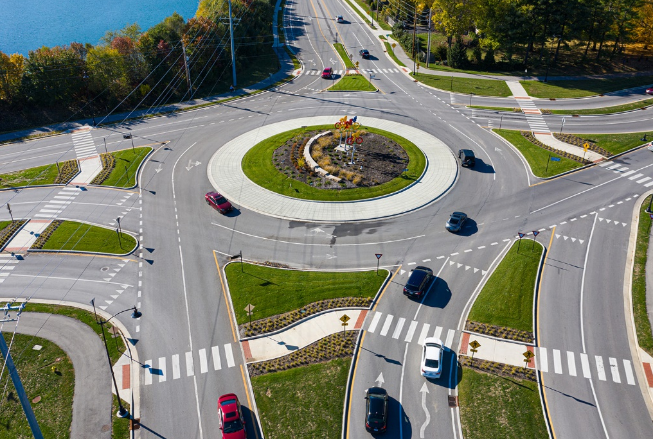
Managing kinetic energy involves:
Managing
speed
Managing
crash angles
Managing
crash energy distribution
Source: Fehr & Peers
Source: City of Carmel, IN
Source: FHWA

Slide 14
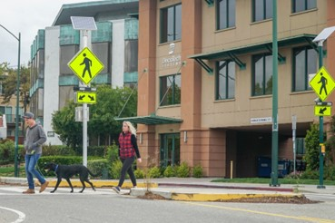
Managing kinetic energy involves:
Separating road users
in space
Separating road users
in time
Increasing road user
awareness
Source: Fehr & Peers
Source: Fehr & Peers
Source: Fehr & Peers

Slide 15
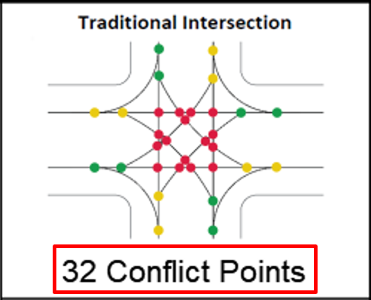
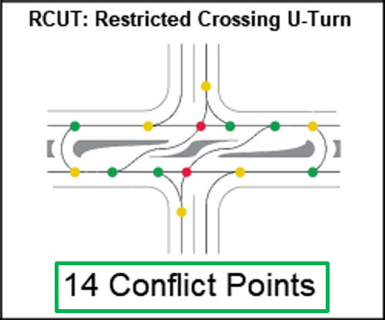
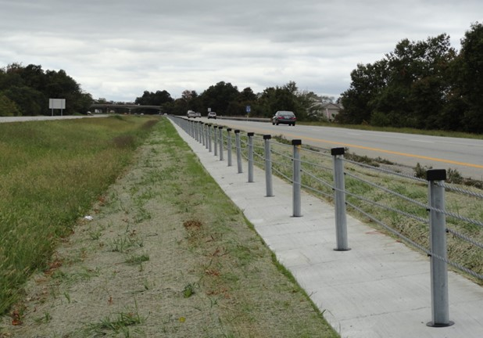
Managing kinetic energy involves:
Analyzing and decreasing conflict points
Preventing high kinetic energy crash types
Source: KYTC
Source: KYTC

Slide 16
Are RSAs in Project Development Really New?
Traditional Safety Review
Road Safety Assessment
The safety review team is not usually independent of the project team. | Performed by a team independent of the project.
Typically performed by a team with only design and/or safety expertise. | Performed by a multi-disciplinary team.
Typically focuses on motor vehicle traffic. | Focuses on ALL road users.
Typically does not consider human factors. | Considers human factors and the capabilities and limitations of the various types of road users.
May not generate a formal report. | Always generates a formal report.
Often does not generate a formal response report. | A formal response report is an essential element.

Slide 17
Benefits of RSAs in
Project Development
Promotes awareness of safe design practices across KYTC and our partners
Helps produce designs that lower the frequency and risk of severe crashes
Gives project teams another opportunity to consider multimodal safety concerns and integrate multimodal best practices

Slide 18
Benefits of RSAs in
Project Development
An excellent opportunity to consider both human factors and human behaviors for all road users in all facets of a project’s design
Human factors are the capabilities and limitations because we are human
I can’t see through a tree (I’m not superman)
We absolutely must design for human factors
Human behaviors are things in which we choose to do
The speed I drive my vehicle is a choice
Our designs may not perfectly control human behaviors, but our designs can have an influence

Slide 19
Benefits of RSAs in
Project Development
Can lower overall project lifecycle costs
Less maintenance costs (e.g. flattened roadside slope vs. guardrail)
Less future reconstruction costs
It’s much more expensive to tweak the design after a project is constructed and in-service vs. adjusting during the D phase
Less societal costs
Fewer severe crashes
Less severe crashes = fewer liability claims for KYTC and our partners, insurance companies, and ultimately the public

Slide 20
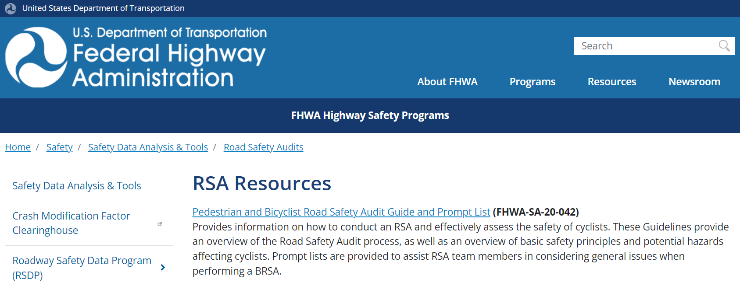
RSA Resources
FHWA’s RSA Resource webpage:
https://highways.dot.gov/safety/data-analysis-tools/rsa/rsa-resources

Slide 21
RSA Resources
FHWA’s RSA Resource webpage:
https://highways.dot.gov/safety/data-analysis-tools/rsa/rsa-resources
RSA guidelines
Ped & bike RSA guidance and prompt list
Using IHSDM in the RSA process
Using 3-D visualization in the RSA process
As we get better using ORD, I suspect 3-D visualization will become easier and extremely useful for RSAs in project development

Slide 22
Why RSAs in Project Development
Identification of roadway elements (or lack of elements) that may present a safety concern
To what extent
To which road users
Under what circumstances
Identification of potential safety improvement opportunities (no matter how small or large) to mitigate identified safety concerns

Slide 23
Questions?
Contact info:
Michael Vaughn, PE
Traffic Safety Branch
Division of Traffic Operations
Kentucky Transportation Cabinet
Mike.Vaughn@ky.gov

